Slide 1
Data Mining
2nd group
Participants:
M10601813 Guillermo Aguilera
M10601836 Frederick Darwin
M10701001 蕭宇陽
M10701016 李文廷
M10701017 許佑瑋

Slide 2
SOM

Slide 3
Number of iterations and learning rate
Learning rate | 0.2 | 0.7
Iterations | 20 | 50 | 100

Slide 4
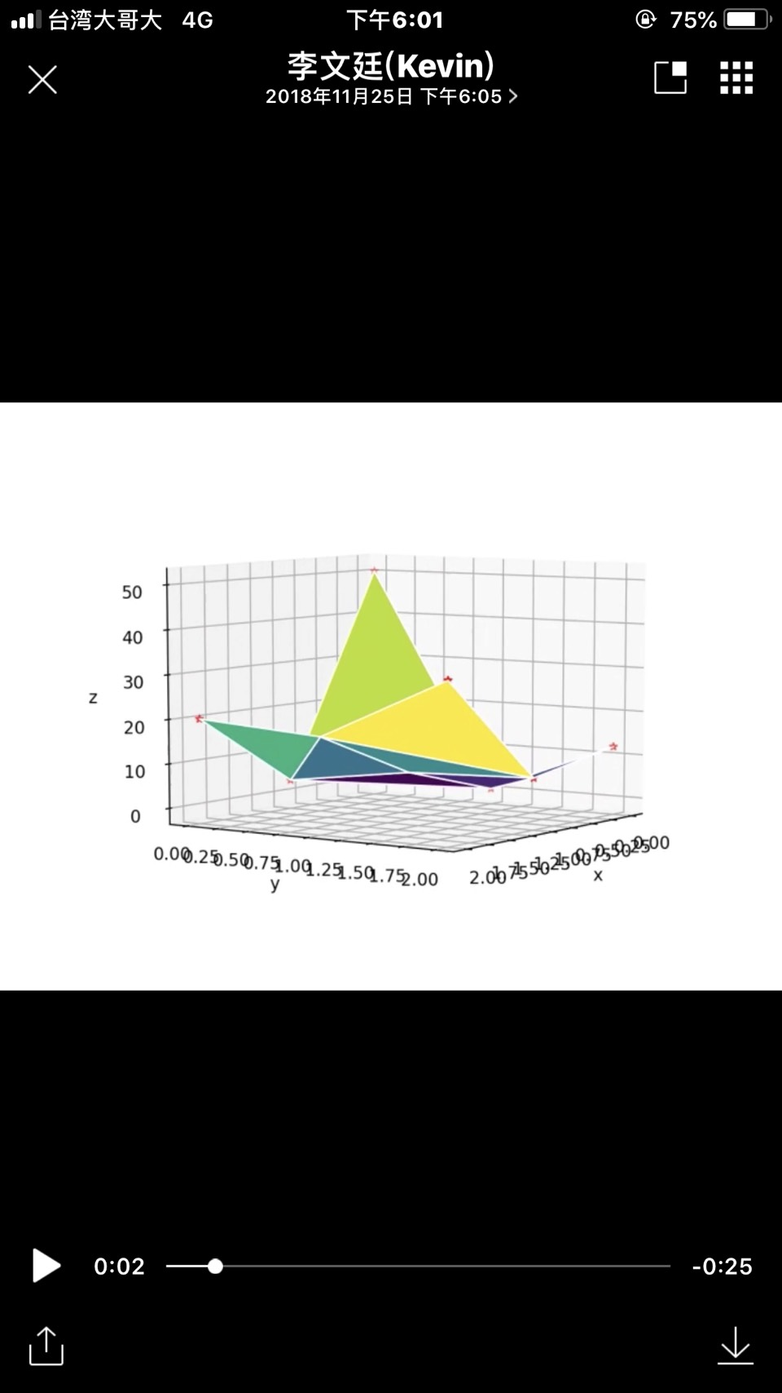
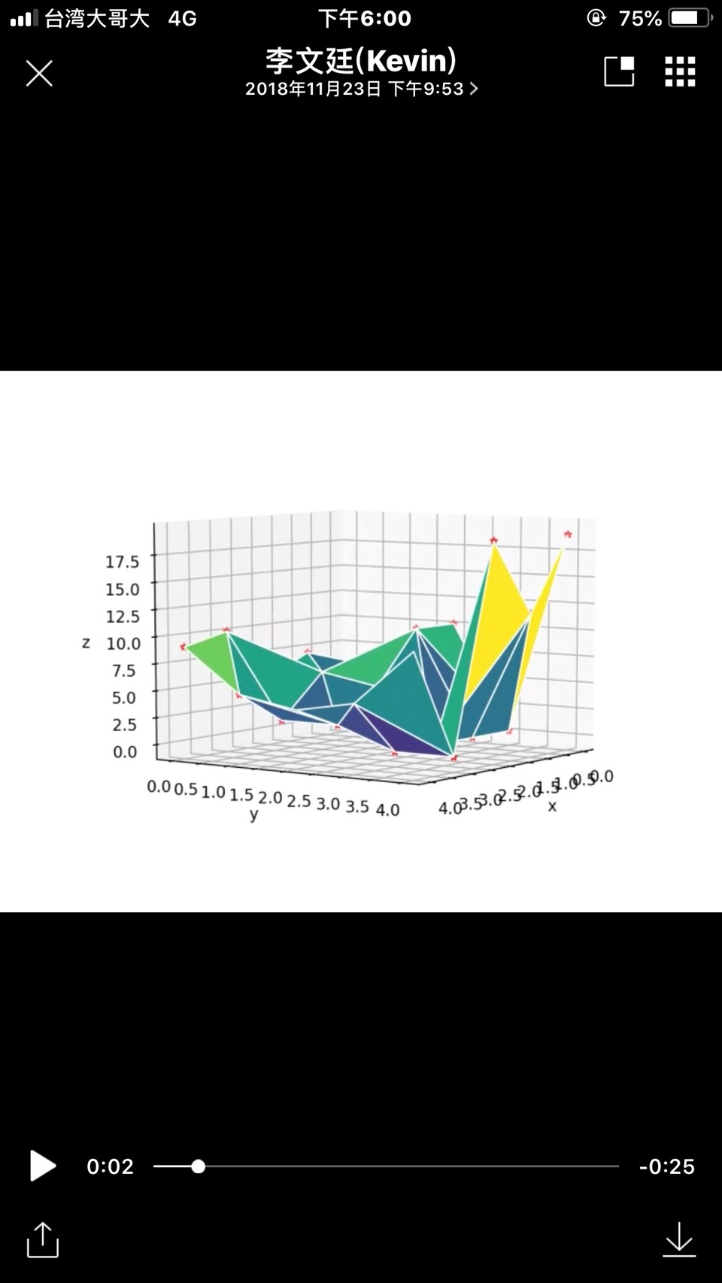
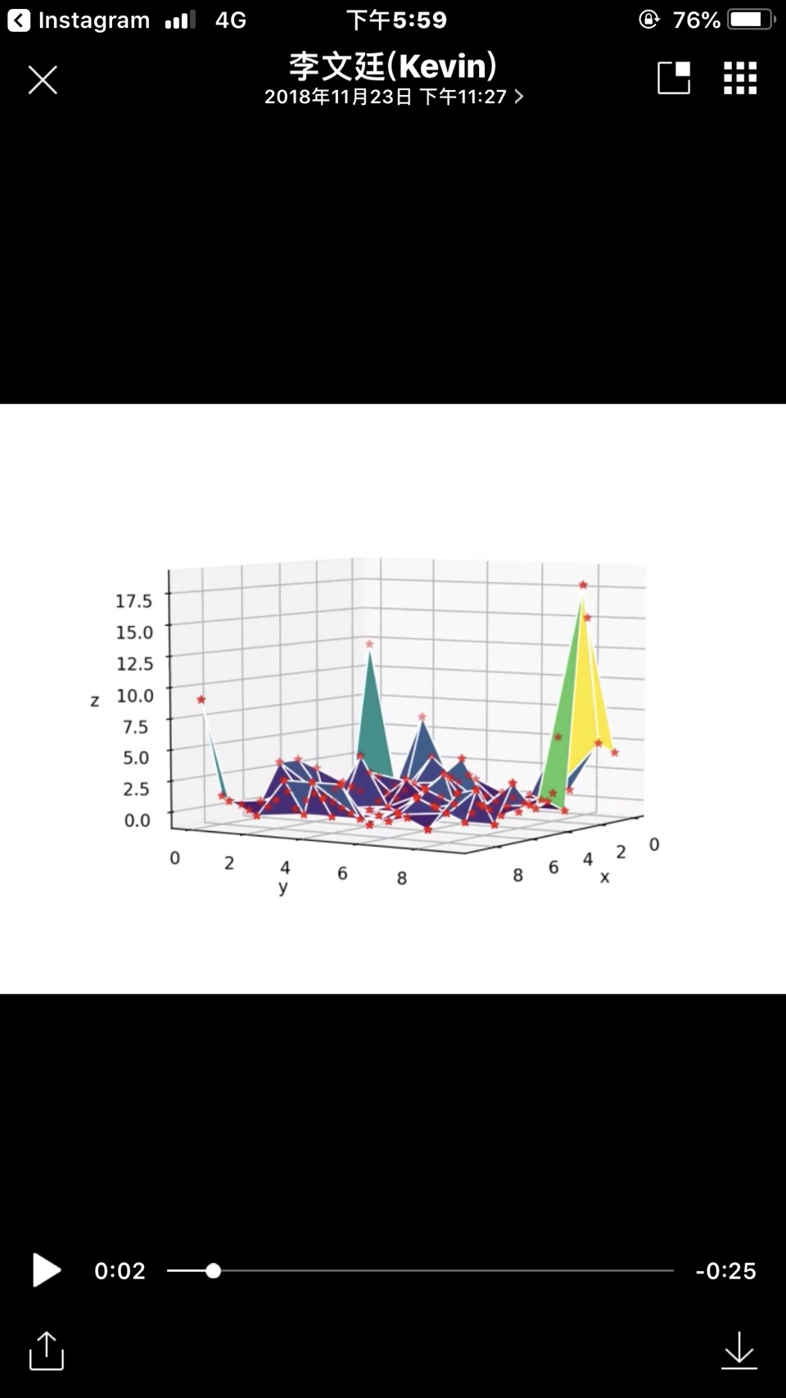
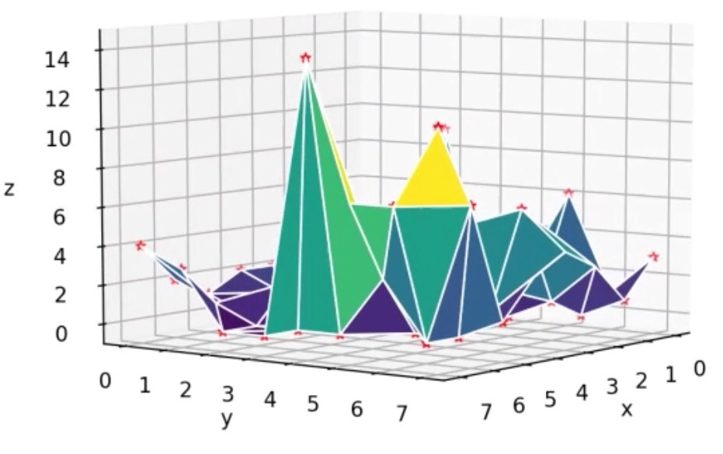
3 x 3
5 x 5
8 x 8
10 x 10

Slide 5
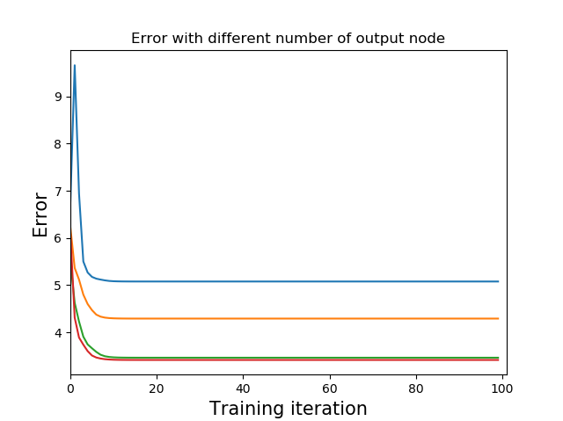
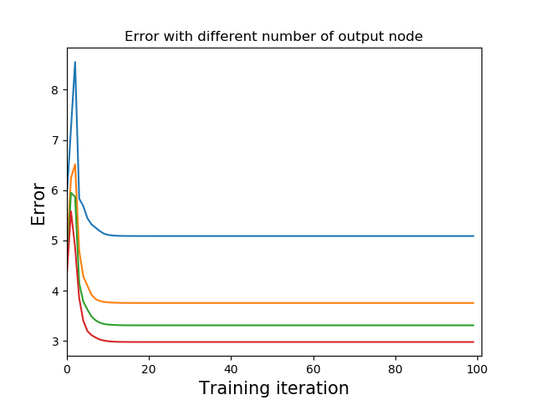
Error Curve
Learning Rate = 0.2
Learning Rate = 0.7
3 x 3
5 x 5
8 x 8
10 x 10

Slide 6
Weka

Slide 7
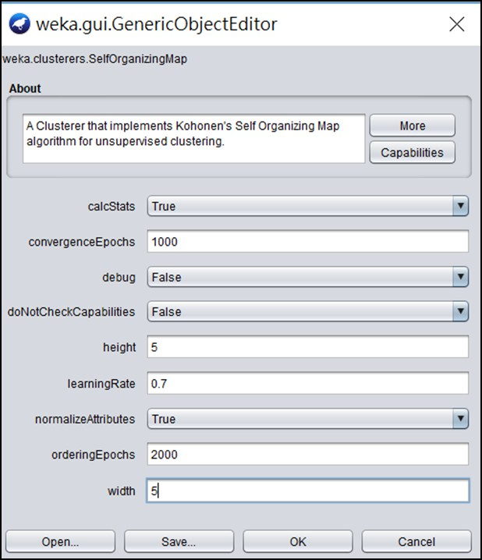
Set up

Slide 8
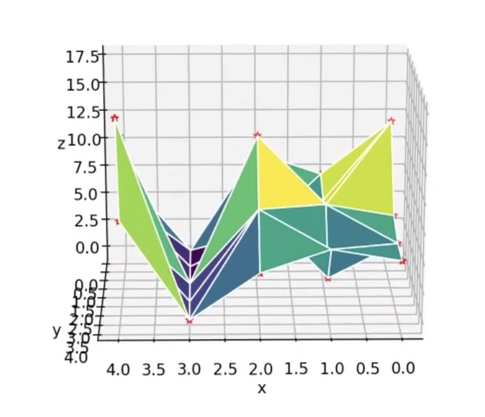
Result
linear separation

Slide 9
Thanks for Your Attention

